Slide 1

UNIVERSITY INSTITUTE OF ENGINEERING
DEPARTMENT OF ACADEMIC UNIT-1
Bachelor of Engineering (CSE)
SUBJECT NAME: Basics Electrical & Electronics Engineering
SUBJECT CODE : 21ELH-101
By
AKHIL NIGAM
TRANSFORMER LOSSES
Lecture No. 9
DISCOVER . LEARN . EMPOWER

Slide 2
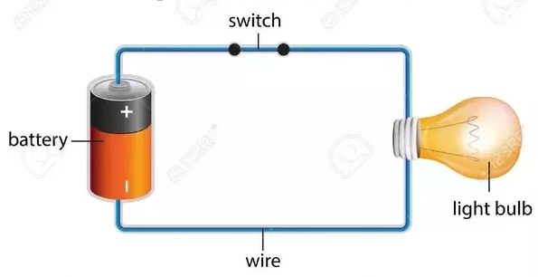
Lecture Objectives
S. No. | Objectives
1 | To make student aware about construction of transformer
2 | To aware about properties of ideal transformer
3 | To provide knowledge about losses in transformer
4 | To aware about to remove losses in transformer
5 | To give knowledge to remove hysteresis losses
https://www.quora.com/What-are-the-differences-between-a-circuit-and-an-electric-circuit

Slide 3
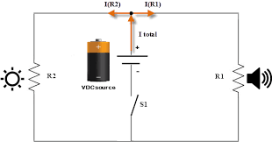
Course Objectives
S. No. | Objectives
1 | To meet students with basic knowledge of dc circuits, electromagnetism and ac fundamentals.
2 | To aware about introduction to single and three phase ac circuit with their construction and working principles.
3 | To provide knowledge about electrical and electronics engineering fundamentals.
4 | To acquire specific knowledge skills so as to comprehend how electric, magnetic and electronic circuits are applied in practice.
https://library.automationdirect.com/basic-electrical-theory/

Slide 4
Course Outcomes
CO Number | Title | Level
CO1 | Identify the different types of electrical elements and the basic op-amp circuit elements and to illustrate the various types of motors, transducers and batteries. | Remember
CO2 | Understand basic principles of transformers, transducers, op-amps, DC and AC motors and to compare the different methods for analyzing electrical and magnetic circuits. | Understand
CO3 | Derive the relationships between parameters in electric and magnetic circuits and motors and to determine specifications of op-amps. | Analyze
CO4 | Solve the basic problems related to electric circuits, magnetic circuits and motors and to assess the characteristics of different configurations of op-amps. | Evaluate
CO5 | Design the different applications of transducers, motors as well as the op-amps like adders, subtractor and comparators. | Create
https://library.automationdirect.com/basic-electrical-theory/

Slide 5
Importance of Basic Electrical & Electronics Engineering
Use from home appliances to industrial plants.
Usage in communication and satellite navigation system.
Handles in electronics equipment and computers.
Deals with the problem of power transmission and motor control.
Control and monitor the medical appliances in hospitals.
High voltage applications with heavy current.
Robotics applications.
Product designing and development.

Slide 6
Contents
Ideal transformer
Losses in transformer
Core losses or Iron losses
Copper loss
Stray losses
Dielectric loss
How to reduced core losses
How to reduced hysteresis losses
Notes:
Computer in the diagram is 3rd generation computer. The period of third generation was from 1965-1971. The computers of third generation used Integrated Circuits (ICs) in place of transistors. A single IC has many transistors, resistors, and capacitors along with the associated circuitry. The main features of third generation are −
IC used
More reliable in comparison to previous two generations
Smaller size
Generated less heat
Faster
Lesser maintenance
Costly
AC required
Consumed lesser electricity
Supported high-level language

Slide 7
Ideal Transformer
An Ideal transformer is an imaginary transformer which has the following properties:
Negligible primary and secondary winding resistances
Infinite permeability (µ)
Zero leakage flux
No losses
Fig1 Ideal Transformer
https://www.javatpoint.com/construction-of-single-phase-transformers

Slide 8
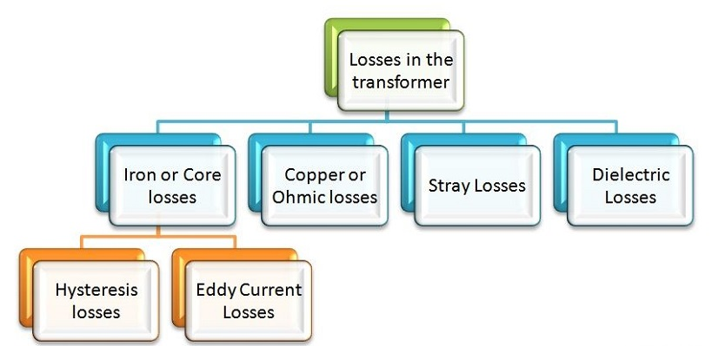
Losses in transformer
Table-1 losses in Transformer
https://circuitglobe.com/types-of-losses-in-transformer.html

Slide 9

Core Losses or Iron Losses
Iron loss: Iron losses are caused by the alternating flux in the core of the transformer as this loss occurs in the core it is also known as Core loss. Iron loss is further divided into hysteresis and eddy current loss.
Hysteresis Loss: The core of the transformer is subjected to an alternating magnetizing force, and for each cycle of emf, a hysteresis loop is traced out. Power is dissipated in the form of heat known as hysteresis loss and given by the equation shown below:

Slide 10
Core Losses or Iron Losses
Where
KȠ is a proportionality constant which depends upon the volume and quality of the material of the core used in the transformer,
f is the supply frequency,
Bmax is the maximum or peak value of the flux density.
2. Eddy Current Loss: When the flux links with a closed circuit, an emf is induced in the circuit and the current flows, the value of the current depends upon the amount of emf around the circuit and the resistance of the circuit.

Slide 11

Core Losses or Iron Losses
Since the core is made of conducting material, these EMFs circulate currents within the body of the material. These circulating currents are called Eddy Currents.
As these currents are not responsible for doing any useful work, and it produces a loss (I²R loss) in the magnetic material known as an Eddy Current Loss.
The equation of the eddy current loss is given as:

Slide 12
Core Losses or Iron Losses
Where,
K_{e} – coefficient of eddy current. Its value depends upon the nature of magnetic material like volume and resistivity of core material, the thickness of laminations
B_{m} – maximum value of flux density in wb/m²
T – thickness of lamination in meters
F – frequency of reversal of the magnetic field in Hz
V – the volume of magnetic material in m³

Slide 13

Copper Loss
These losses occur due to ohmic resistance of the transformer windings.
If I₁ and I₂ are the primary and the secondary current. R₁ and R₂ are the resistance of primary and secondary winding then the copper losses occurring in the primary and secondary winding will be I₁²R₁ and I₂²R₂ respectively.
Therefore, the total copper losses will be

Slide 14
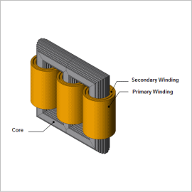
Stray Loss
The occurrence of these stray losses is due to the presence of leakage field.
The percentage of these losses are very small as compared to the iron and copper losses so they can be neglected.
Fig-2 Stray Losses
https://www.jmag-international.com/catalog/202_powertransformer_corestrayloss/

Slide 15
Dielectric loss
Dielectric loss occurs in the insulating material of the transformer that is in the oil of the transformer, or in the solid insulations.
When the oil gets deteriorated or the solid insulation gets damaged, or its quality decreases, and because of this, the efficiency of the transformer gets affected.

Slide 16
How to reduce core losses
Eddy Current loss can be reduced by increasing the number of laminations.
The laminations provide small gaps between the plates.
As it is easier for magnetic flux to flow through iron than air or oil, stray flux that can cause core losses is minimized. Reducing eddy currents.

Slide 17
How to Reduce Hysteresis Losses
Hysteresis loss can be reduce by using material having least hysteresis loop area.
Hence silicon steel or high grade steel is used for manufacturing of a transformer core as it is having very less hysteresis loop area.

Slide 18
Frequently Asked Questions
1.) How to minimize Eddy current loss?
By using less thickness of laminations
By using less value of Magnetic flux density
2.) How to minimize Hysteresis loss?
By using good magnetic material.
By using less value of Magnetic flux density
3.) Why transformers are rated in kVA ?
A:Copper loss of a transformer depends on current and iron loss on voltage . So rating is in kVA.

Slide 19
Summary
Through this PPT , the students have learned and understood
Terminology of magnetic circuits
Ideal Transformer
Different types of losses
How to reduce losses
Causes of losses

Slide 20
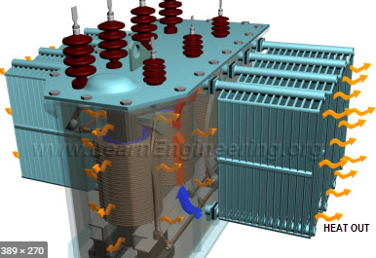
Learning Outcomes
To make students understand the
Construction of transformers
Performance analysis of transformer
Terminology of magnetic circuits.
Concept of self and mutual induction.
Principle of operation of transformers.
https://www.google.com/search?q=transformer+working+and+construction&source=lnms&tbm=isch&sa=X&ved=2ahUKEwjf7q2zo5XqAhXbb30KHcZ1A-MQ_AUoAnoECBEQBA&biw=1366&bih=608#imgrc=Hz4hgKww9splRM&imgdii=-GHifX4ZDm1raM

Slide 21
Course Outcome to Program Outcome Relationship
 |  | (21ELH-101) BEEE
PO→
CO↓ | PO1 | PO2 | PO3 | PO4 | PO5 | PO6 | PO7 | PO8 | PO9 | PO10 | PO11 | PO12 | PSO1 | PSO2 | PSO3
CO1 | 3 | 2 |  |  |  |  |  |  |  |  |  |  | 3
CO2 | 3 | 2 |  |  |  |  |  |  |  |  |  |  | 3
CO3 | 3 | 2 |  |  |  |  |  |  |  |  |  |  | 3
CO4 | 3 | 2 |  |  |  |  |  |  |  |  |  |  | 3
CO5 | 3 | 2 |  |  |  |  |  |  |  |  |  |  | 3

Slide 22
Assessment Pattern
A Assignment (each assignment) | B Time Bound Surprise Test (each test) | C Quiz (each quiz) | D Mid Semester Test(one per test) | E Homework | F Discussion Forums | G Attendance and engagement Score on BB
10 | 12 | 4 | 20 | NA | NA | 2

Slide 23
REFERENCES
https://circuitglobe.com/types-of-losses-in-transformer.html
https://www.electricaleasy.com/2014/04/transformer-losses-and-efficiency.html
https://www.electronics-tutorials.ws/transformer/transformer-basics.html
Reference books:
https://www.amazon.in/s?k=electrical+transformer+book&crid=1T23UDIK31LYD&sprefix=transformer+books+in+ele%2Caps%2C368&ref=nb_sb_ss_i_1_24

Slide 24
THANK YOU
For queries
Email:akhilnigam.eee@cumail.in

